Slide 1

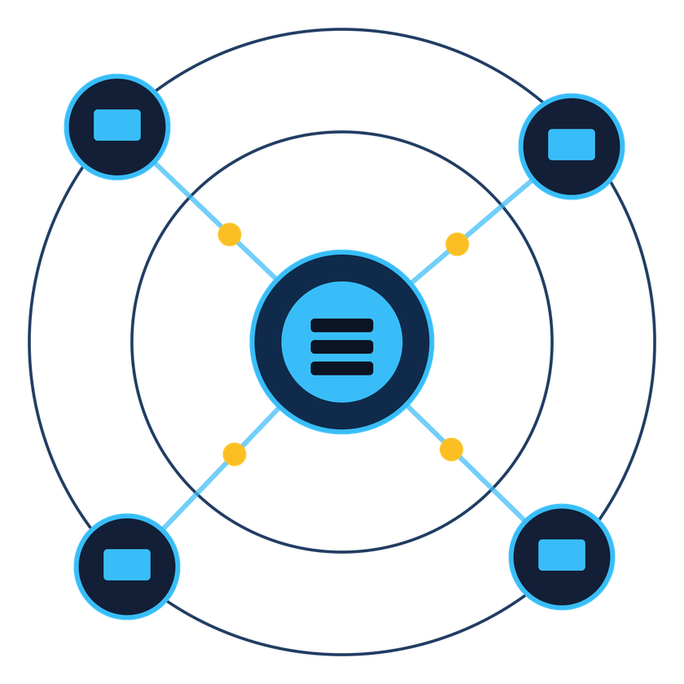
COMPUTER NETWORKS (MINI-PROJECT)
LAN-Based Collaborative Whiteboard
Real-time drawing for every device on the network, built on HTTP, TCP and WebSocket.
Vedant Pawaskar
Prajakta Choughule
Yashraj Agale
Bhavya Maisuria
1262242102
1262241465
1262242073
1262243418
TY B.Tech (CSE) · Semester V · 2026–27
Notes:
Introduce the team and the project. One line: a whiteboard that any browser on the same LAN can draw on, live, using a small Python server.
1

Slide 2
01 · WHY THIS PROJECT
Problem and Objectives
01
02
Browser-based whiteboard for devices on one LAN
Central server that receives and broadcasts events
Teams need one shared board, live, on every device.
Students explain diagrams, topologies and calculations together. A physical board is not always available, and screenshots are never live. This project turns any browser on the LAN into a shared canvas.
03
04
HTTP for the page, WebSocket for live updates
Structured JSON messages for every action
05
06
Join, leave and re-join with full state sync
Test, measure and relate results to theory
LAN Collaborative Whiteboard · Computer Networks
02
Notes:
State the problem in one sentence, then walk through the six objectives. Stress that the goal is to demonstrate networking concepts, not just a drawing app.
2

Slide 3






02 · THEORY IN PRACTICE
Networking Concepts Used
Unit I
Unit III
Unit I
LAN
IP and Ports
Client–Server
Wi-Fi or Ethernet star network; clients reach the host directly.
LAN IP picks the machine; port 8000 picks the program.
Browsers talk only to the central FastAPI server.
Unit V
Unit V
Unit IV
HTTP
WebSocket
TCP
GET / delivers the page, CSS and JavaScript.
One persistent two-way channel, upgraded from HTTP.
Reliable, ordered delivery of every message.
Unit tags refer to the course syllabus · LAN Collaborative Whiteboard
03
Notes:
Each concept is tagged with the syllabus unit it belongs to. Spend a sentence on each: LAN, IP and port, client-server, HTTP, WebSocket, TCP.
3

Slide 4
03 · LAYERS AT WORK
Protocol Stack
Application
JSON messages: DRAW, ERASE, CLEAR, SYNC
ENCAPSULATION OF ONE STROKE
HTTP and WebSocket
Page delivery, then the live channel at ws://host:8000/ws
JSON message
→ WebSocket frame
→ TCP segment
→ IP packet
→ Wi-Fi or Ethernet frame
TCP
Reliable, ordered byte stream to destination port 8000
IP
Host LAN address such as 192.168.x.x; routes packets
TCP keeps segments in order, so strokes draw in the sequence they were made.
Link: Wi-Fi or Ethernet
Frames over the access point or switch (CSMA/CA on Wi-Fi)
LAN Collaborative Whiteboard · Computer Networks
04
Notes:
Walk top to bottom. Point out that the application never sees Wi-Fi or IP details: each layer only talks to the one below. Encapsulation on the right shows one drawing stroke going down the stack.
4

Slide 5
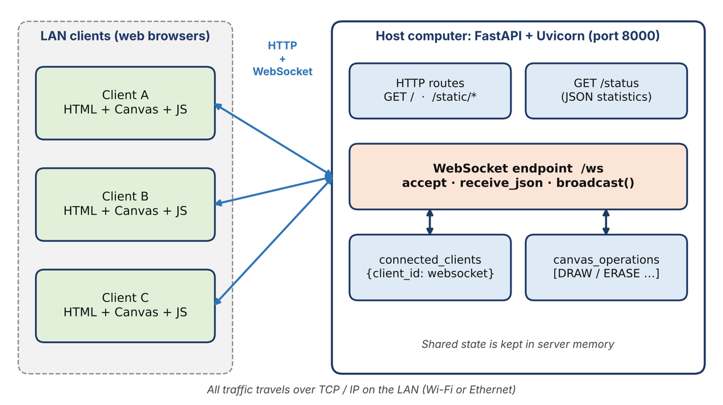
04 · HOW IT FITS TOGETHER
System Architecture
Browser clients
HTML, Canvas and JavaScript capture pointer events and render what they receive.
FastAPI and Uvicorn
Serves the page over HTTP and accepts live connections at /ws.
Shared state
An in-memory client list and drawing history let late joiners catch up.
LAN Collaborative Whiteboard · Computer Networks
05
Notes:
Star topology: every client talks only to the server. Contrast with peer-to-peer, where N clients would need up to N(N-1)/2 connections. The server is also the single point of failure, which we list as a limitation.
5

Slide 6
05 · APPLICATION LAYER
From HTTP to WebSocket
1
2
3
4
HTTP request
Upgrade
101 Switching
Live channel
GET / returns index.html, style.css and app.js.
Browser asks GET /ws with an Upgrade: websocket header.
The same TCP connection now carries WebSocket frames.
Either side sends at any moment; no polling needed.
HTTP POLLING
WEBSOCKET
A new request and full headers every time, and updates arrive only at the next poll.
One handshake, then small frames pushed the instant a stroke is drawn.
LAN Collaborative Whiteboard · Computer Networks
06
Notes:
WebSocket starts life as an HTTP request, so it passes through the same ports and infrastructure. After 101 Switching Protocols, HTTP is no longer used on that connection. The client picks ws:// or wss:// from the page protocol.
6

Slide 7
06 · DATA FORMAT
Message Protocol
{
"type": "DRAW",
"user_id": "a3f9c1d2",
"x": 125, "y": 210,
"prev_x": 118, "prev_y": 203,
"color": "#111111",
"width": 4
}
Event | Direction | Purpose
DRAW | C → S → all | Draw one segment
ERASE | C → S → all | Erase one segment
CLEAR | C → S → all | Clear the board
SYNC | S → joiner | Replay stored drawing
WELCOME | S → joiner | Client id, users online
USER_JOINED / LEFT | S → others | Update online count
PING / PONG | C ↔ S | Latency probe
Each message is one line segment: the current and previous point, so receivers redraw it exactly.
C = client, S = server · LAN Collaborative Whiteboard
07
Notes:
JSON is easy to produce in JavaScript and parse in Python. A message is a few hundred bytes at most, far smaller than sending an image of the board. The server adds a timestamp and broadcasts DRAW and ERASE to every connected client.
7

Slide 8
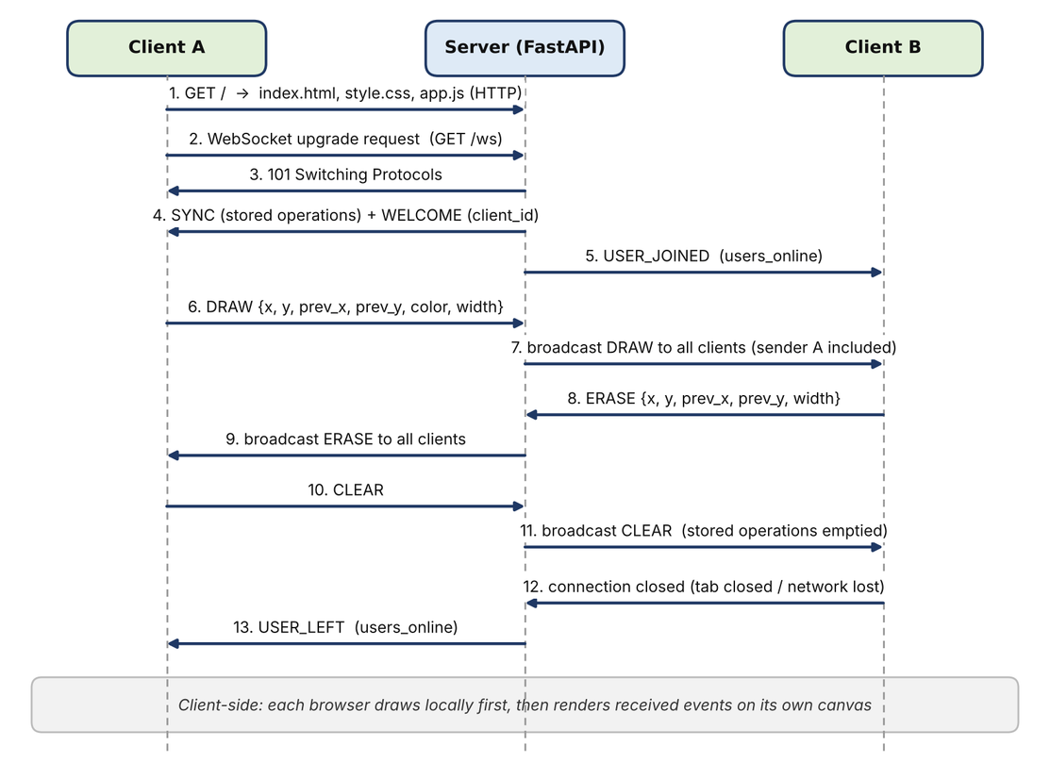
07 · END-TO-END WORKING
Message Flow
Join
The new client gets the stored drawing (SYNC), then its id (WELCOME).
Draw
The server stores each segment and broadcasts it to every connected client.
Leave
A closed connection is removed and USER_LEFT updates everyone's count.
LAN Collaborative Whiteboard · Computer Networks
08
Notes:
Read the diagram top to bottom: HTTP page load, WebSocket upgrade, SYNC and WELCOME, then draw, erase and clear events, and finally a disconnect. Note that broadcast() also sends each event back to the sender, who simply redraws the same segment.
8

Slide 9
08 · BUILDING IT
Implementation
Server · main.py
  Serves / and /static over HTTP
  Accepts /ws and tracks every client
  Stores strokes; replays SYNC to joiners
THE BROADCAST LOOP (SIMPLIFIED)
async def broadcast(message, exclude=None):
for client_id, ws in list(connected_clients.items()):
if client_id == exclude:
continue
try:
await ws.send_json(message)
except Exception:
connected_clients.pop(client_id, None)
Client · app.js
  Turns pointer moves into JSON events
  Renders DRAW, ERASE and CLEAR
  Reconnects automatically every 2 s
Run with: uvicorn main:app --host 0.0.0.0 --port 8000
Python · FastAPI · Uvicorn · HTML5 Canvas · JavaScript
09
Notes:
The server is under 150 lines of Python. Binding to 0.0.0.0 means it listens on every interface; clients use the host's real LAN IP in the URL. A client whose send fails is dropped from the dictionary so dead connections are never reused.
9

Slide 10

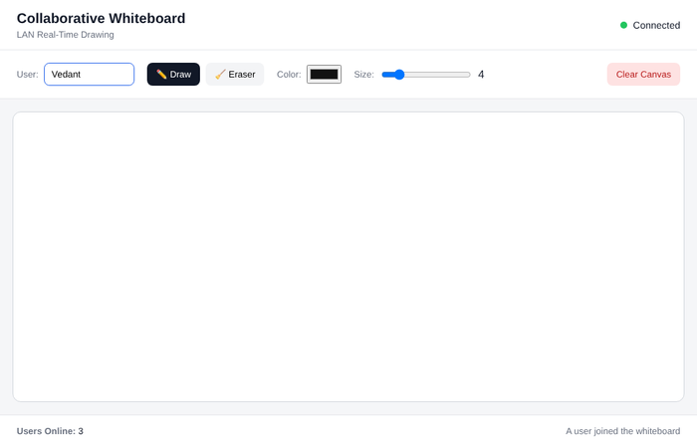
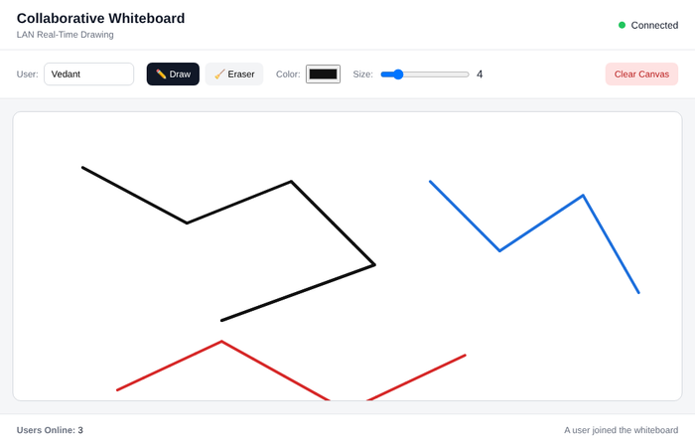
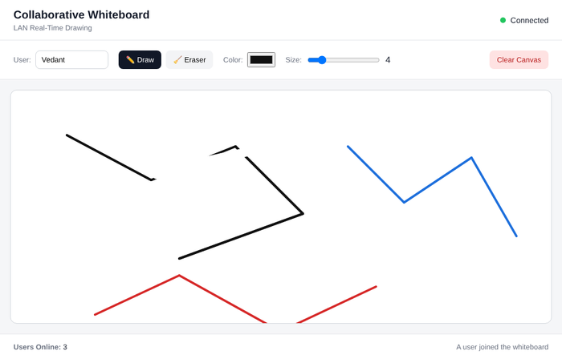
09 · SEEING IT WORK
Live Demonstration
1 · Connect. Three clients join; every screen shows Users Online: 3.
2 · Draw. Strokes from three users appear on every canvas.
3 · Erase. An erase by Client B shows up on Client A.
Captured from the running application · LAN Collaborative Whiteboard
10
Notes:
These screenshots come from three browser clients connected to one server. All three canvases ended with exactly the same number of drawn pixels (3,776). Replace or extend with your own photos from the physical LAN demo.
10

Slide 11
10 · EVIDENCE
Test Results and Performance
9 / 9
0.21 ms
500 / 500
12
test cases passed: connect, draw, erase, clear, join, leave, restart, load
mean delivery delay, client to server to client (200 events)
events received by each of 9 receivers, none lost
simultaneous WebSocket clients handled by one server
Robustness
Honest scope
Malformed JSON closed only that client; others continued. After a server restart a new client received an empty board.
Measured on the loopback interface with all clients on one machine. Wi-Fi adds delay, so re-measure on the physical LAN.
PING to PONG round trip: mean 0.17 ms · LAN Collaborative Whiteboard
11
Notes:
All figures come from the real running server. Loopback numbers show the server adds very little delay; they are lower bounds. On the day, repeat the PING test over Wi-Fi and quote those numbers instead.
11

Slide 12
11 · WRAPPING UP
Limitations, Future Work, Conclusion
Limitations
Future work
Conclusion
  No login or encryption; trusted LAN only
  Drawing lives in memory and is lost on restart
  One server is a single point of failure
  History grows without limit in long sessions
  Rooms with access codes and user names
  Persistent storage and undo / redo
  Throttle events and skip the sender
  Test on Wi-Fi and inspect with Wireshark
A browser loads the page over HTTP, upgrades to WebSocket on TCP, and exchanges small JSON messages with one FastAPI server that stores, broadcasts and replays the drawing.
Thank you · Questions?
Vedant Pawaskar · Prajakta Chougule · Yashraj Agale · Bhavya Maisuria
LAN Collaborative Whiteboard · Computer Networks
12
Notes:
Be upfront about limitations: it is a learning prototype for a trusted network. Close by repeating the one-sentence summary and invite questions.
12

